Slide 1
Monitoring Management

Slide 2
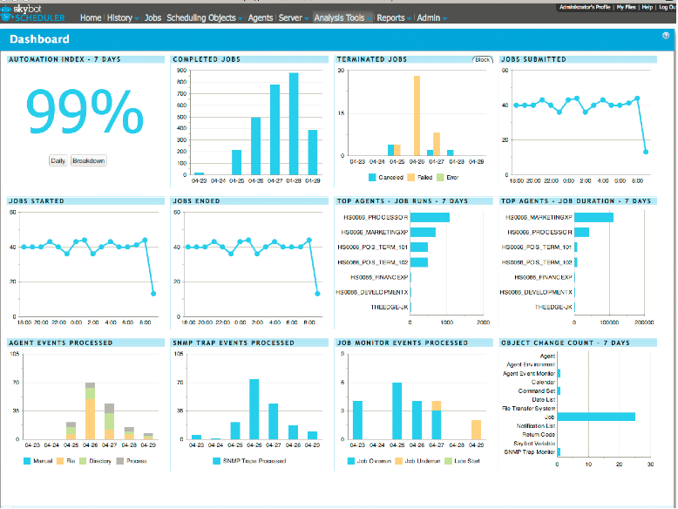
Agenda
A Good DevOps Engineer always believes to ACT rather than to REACT.
What is Monitoring and Why it's required?
Important Areas
Infrastructure Monitoring
Application Monitoring
Log Monitoring
Other Tools
Alerts & more
FAQ

Slide 3




What is Monitoring and Why it’s required ?
Detect Problems before the end users are affected.
Alerts and Notification on the critical issues and events.
If you are AWARE, then you can ACT.
Collection of Data against the issues encountered and create automatic response for next time it occurs.
Statistics and Analysis
Visibility for prioritizing important alerts and events.
Increased Availability and UPTIME.

Slide 4









Important Areas
Application
Monitoring
Infrastructure
Monitoring
Logs & User Actions

Slide 5
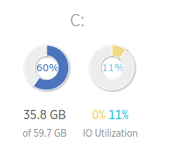
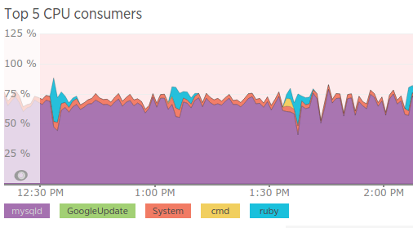
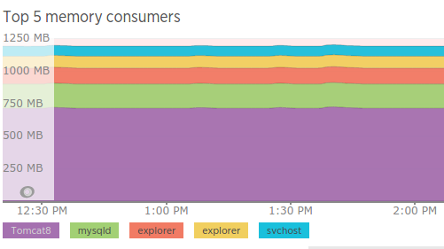
Infrastructure Monitoring
Fewer Important Metrics
Server Checks (CPU,RAM,IO….)
Process Monitoring
Services Status
Network

Slide 6
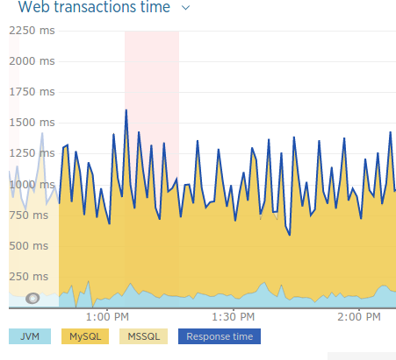
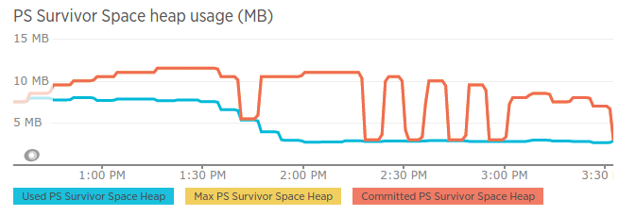
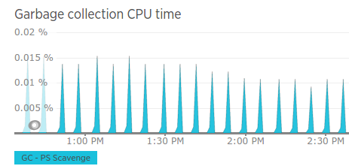
Application Monitoring
Fewer Important Metrics
JVM Params(heap size,threads...)
Slow Functions and Procedure Calls
Web Transactions
DB Connections

Slide 7
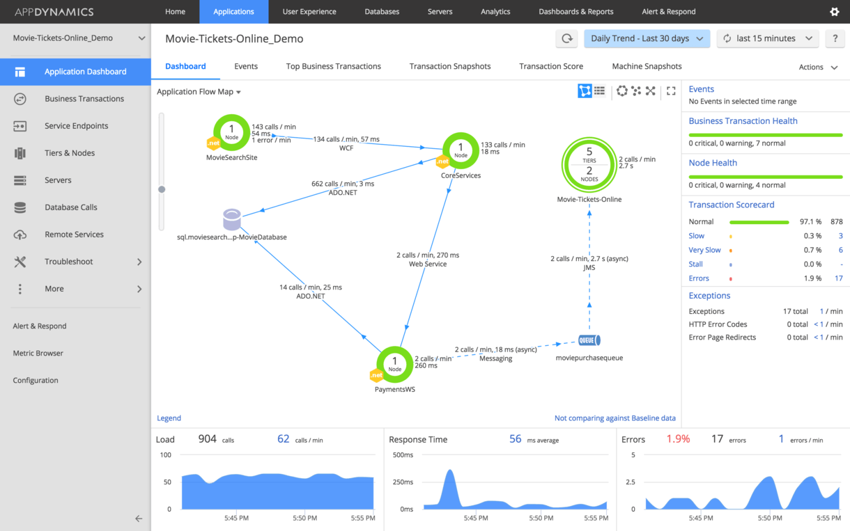
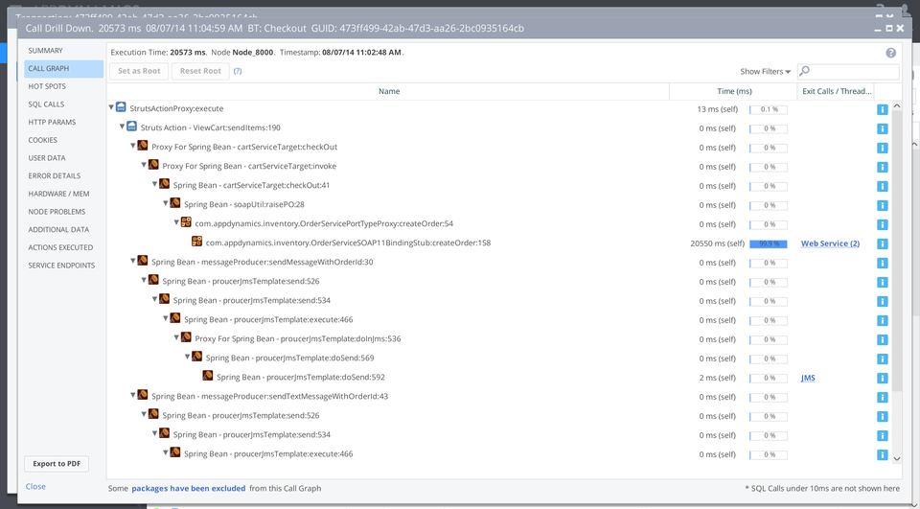
Application Monitoring
Debugging at the code level
Data flow
Service Maps
External API and Service Calls

Slide 8
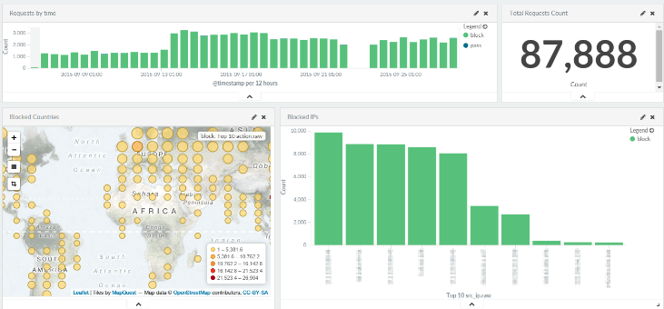
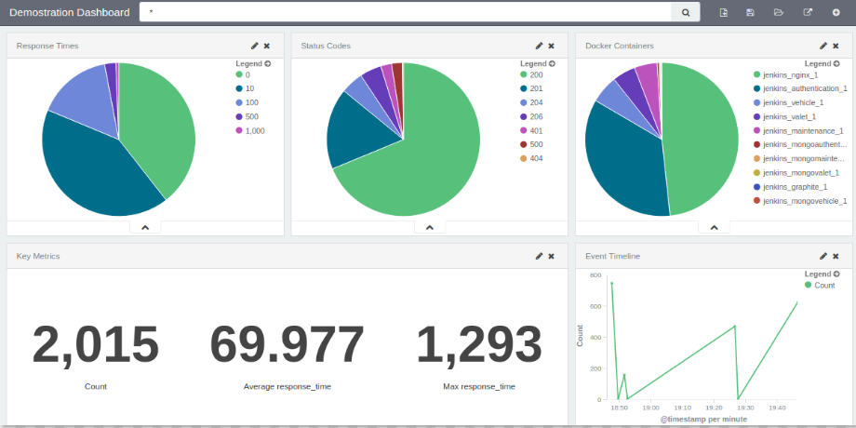
Log Monitoring
Errors and Exceptions Messages
Log Level to Debug Mode
Capture and Count the Events in the logs
Traffic Analysis

Slide 9
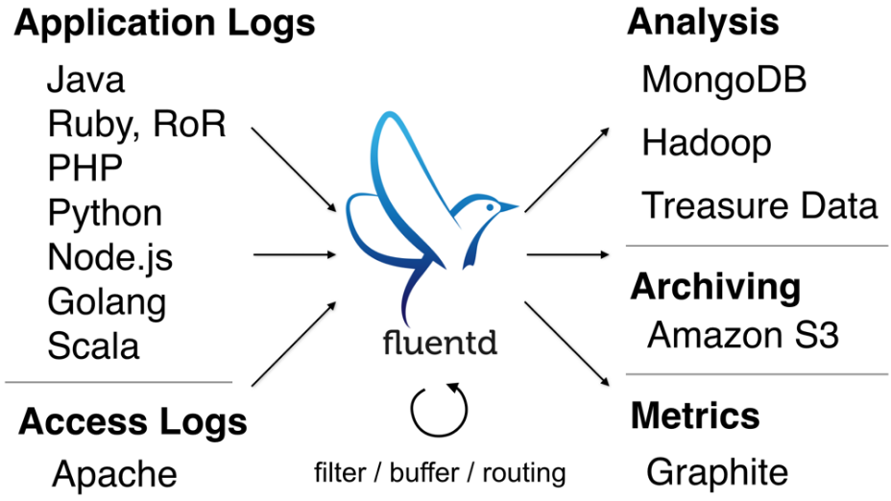

Slide 10







Other Tools

Slide 11

Models Offered
Monitoring Application Vendors offers various models based on the requirements :-
Freeware
Per Host
Per host-hour
Per user
Per Alert
Per Storage Byte

Slide 12



Alerts & more ...
Perform Alert Testing on defined Intervals
Treat the Application as a blackbox
Define Expected Response to alerts
Tests from various geographic locations
Alerts via email, phone or sms
Periodic Tests via bots

Slide 13

Questions ?
Precise Monitoring helps the DevOps to Relax

